Slide 1
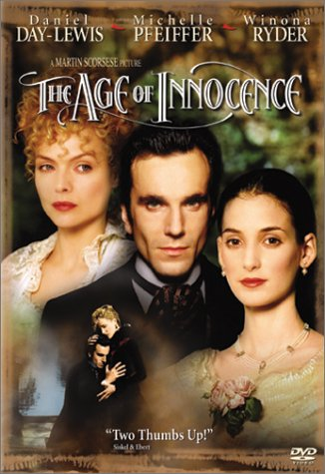
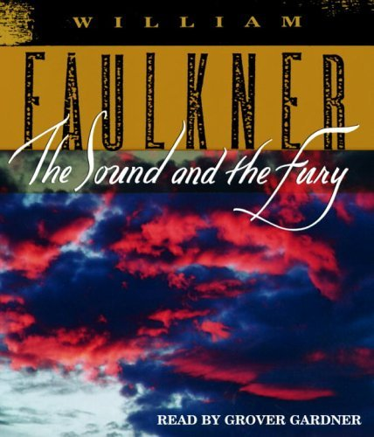
Comparing between the age of innocence's and the sound and the fury novels.
age of innocence's
the sound and the fury

Slide 2
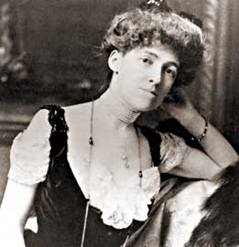
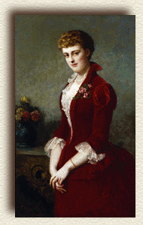
The age of innocence's by Edith Wharton

Slide 3
Edith Wharton
Edith Wharton was a Pulitzer Prize-winning American novelist, short story writer and designer.
Wharton was born in New York City to parents George Frederic Jones and Lucretia Stevens Rhinelander. When she was thirteen, she published a collection of poetry at her own expense. In 1885 she married Edward Wharton of Boston. During World War I, Edith was active in relief work in France. In 1915, she was decorated with the Cross of the Legion of Honor for her service. She was awarded the Pulitzer prize for literature in 1920 for her novel "The Age of Innocence". She died in France in 1937 of a stroke.

Slide 4
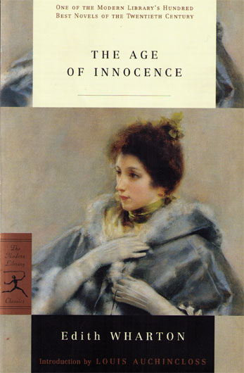
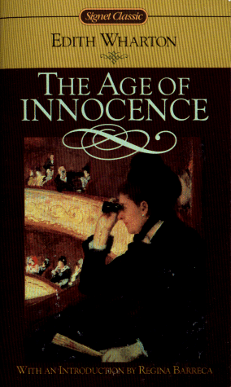
The age of innocence's :

Slide 5
The Age of Innocence centers on an upper class couple's impending marriage, and the introduction of a scandalous woman whose presence threatens their happiness. Though the novel questions the assumptions and morals of 1870s' New York society, it never devolves into an outright condemnation of the institution. In fact, Wharton considered this novel an "apology" for her earlier, more brutal and critical novel, The House of Mirth. Not to be overlooked is Wharton's attention to detailing the charms and customs of the upper caste.

Slide 6
Protagonist
Newland Archer, a young man who fits perfectly into his small social group and plans to marry a respectable girl and live a respectable life, is the protagonist of the novel. He meets Ellen Olenska and undergoes a change of heart in which he realizes New York society is stifling him. Throughout most of the novel, he struggles with his conflicting desires. In the end, he is restored to society and gives up his passions, but he is content with this choice.

Slide 7
Themes :
The themes explored by Wharton suggest more than the trivia of her medium would indicate. She constantly barrages the reader with how ridiculous and arbitrary New York society can be in the 1870's. She speaks of the tumultuous state of this society in ways that are witty, biting and cynical. Her ultimate indictment is not of how pitiful the life of a young man can be if deprived of personal freedom, but rather the criminality of depriving anyone of their liberty. Perhaps in writing about Newland's predicament, Wharton attempts to illustrate the value and honesty of another novel relating a similar dilemma.

Slide 8
Climax
There are several climactic moments in the novel, including the moment Newland Archer realizes he loves the Countess Olenska and wants to marry her instead of marrying May Welland, his fiancée, and the moment he decides to leave his wife and consummate his affair with Ellen. The final climactic moment, however, occurs when Newland realizes he cannot do as he longs to. May has told Ellen about her pregnancy and Ellen will no longer carry on the relationship with Newland, nor will she even give him one night. He has been fooling himself into thinking her hesitation can be conquered. In this moment at the end of the novel, Newland must accept the fact that obligations of society and family are too strong; he has been conquered.

Slide 9
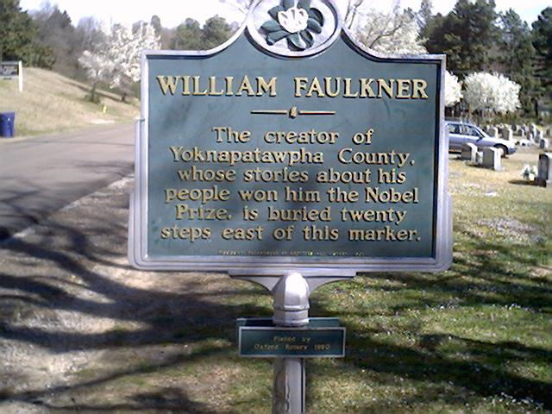
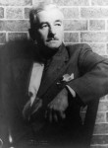
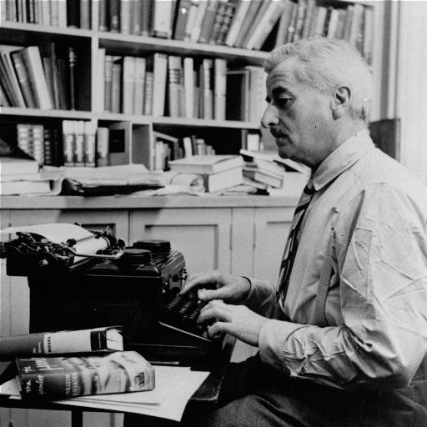
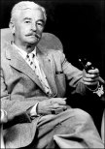
The sound and the fury by “William Falkner“

Slide 10
“William Falkner“
William Cuthbert Falkner was born in New Albany, Mississippi, on September 25, 1897.
Faulkner’s writing career began with poems, some of which were published. A play he wrote was performed in 1921, and his first book of poems was published in 1924. In 1925 he met Sherwood Anderson, best known as the author of Winesburg, Ohio, who influenced him to become a fiction writer.

Slide 11
Following the trend of other American writers, Faulkner made a six-month tour of Europe in 1925. On his return to the United States, he began writing seriously. In 1929, he saw the appearance of The Sound and the Fury, the work which first gained him critical notice.
In 1949, he received the Nobel Prize for Literature and in 1955 he received the National Book Award and the Pulitzer Prize for A Fable, a story of France during World War I. Faulkner suffered a number of injuries caused by falls from horses. he died of a heart attack on July 6, 1962.

Slide 12
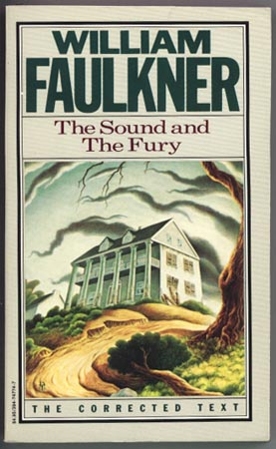
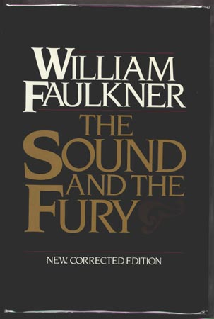
“ The Sound and the fury “

Slide 13
The Sound and the Fury is a novel written by the American author William Faulkner. It employs a number of narrative styles, including the technique known as stream of consciousness, pioneered by 20th century European novelists such as James Joyce and Virginia Woolf. Published in 1929,
It is a difficult work that has posed many problems for both readers and teachers. This hypertext of the novel and related materials is designed as a unique means of exploring the text of the novel, and of augmenting its study, for all levels of readers.

Slide 14
Protagonist
The protagonist is Caddy--she is the object of attention or affection throughout the novel, and the knot that ties all sections of the novel together. She is a different person in the eyes of each different character.
Caddy, independent of the other characters, is nothing; she is only shown through the biases of the others. Thus, she is unable to have any traits whatsoever - she does not exist as a person. The idea of Caddy, not the character, is what is actually the protagonist in the novel.

Slide 15
Other Character :
Miss Quentin is Caddy's daughter and resembles her in character traits, but does not have any significance on the other characters, with the exception of Jason. To Jason, Miss Quentin is merely another Caddy - another object of (self-) hatred.
Mr. and Mrs. Compson are foils to Jason, and representative of the old ideals and traditions. They change as time goes on, and they both pass away. Jason prevails, but not morally; thus, the ideals of Mr. and Mrs. Compson die with them.
Other characters that have not yet been mentioned contributed to the plot, but not to the deeper meaning of the novel. This includes such static and shallow characters as Herbert Head, Gerald Bland, etc.

Slide 16
Themes :
One theme of the novel is that a sense of inevitability ensnares all of existence. This is especially evident in Quentin's section, while he prepares to kill himself. Time is constantly an issue to Quentin, and the time draws nearer to the time of his death as the section progresses linearly.
Another theme is that love is not enough to conquer hate; the two merely negate the effects of each other and cease to exist. A reaction between matter and antimatter results in absolutely nothing - neither exist, yet nothing is produced. In this way, the love of Dilsey and the hate of Jason cancel each other out, leaving the Compson family void of meaning. This illustrates the nihilist principles that Faulkner endorses.
Yet another theme is that meaninglessness is perfection. Benjy is unable to think, and unable to communicate. He is the embodiment of innocence. He is the most "perfect," the most moral character - yet is void of any "meaning" that the other characters have. Jason is portrayed negatively and is essentially the opposite of Benjy - worldly, angry, and corrupt - and completely immoral.

Slide 17
Climax
Rather than reach a climax at the end of the novel, it reaches an anti-climax (in keeping with the nihilist philosophy and underlying meaninglessness). The Compsons, one by one, cease to have meaning. For some, it is by ceasing to exist (as in the case of Quentin and Mr. Compson). For others, it is by losing whatever meant anything to them specifically (as in the case of Jason and Benjy). And so, the novel recedes back into the meaninglessness from whence it came.
Miniature climactic events are witnessed throughout the novel - these are more turning points than actual climaxes. If a single event could be called a climax, it would have to be the point at which Miss Quentin steals Jason's money and runs away. That is the single event that leads to the downfall of what is left of the Compson family.

Slide 18
Thank You..
Eman Ahmad AL.Ghamdi
Salha Hussain AL.Montasheri
Areej Ahmad Khalf
Nawal AL.Amri
Doa’a Nashag8i

